Slide 1

BOLO
Version 7
Team Members: Mario Siu, Rachel Hill, Victor Estopiñán Product Owner: Jason Cohen, Frank Alvarado
Instructor: Masoud Sadjadi School of Computing and Information Sciences Florida International University
Final Presentation
Spring 2017
Notes:
7 seconds.( I will select 2 best slides (i will give them extra points and students will present for CIS committee)
Greet your audience, thank them for attending your presentation, introduce yourself, introduce your project, introduce your team members, and quickly indicate what each of you did in a high-level manner, and put more emphasis on your part/contribution.

Slide 2
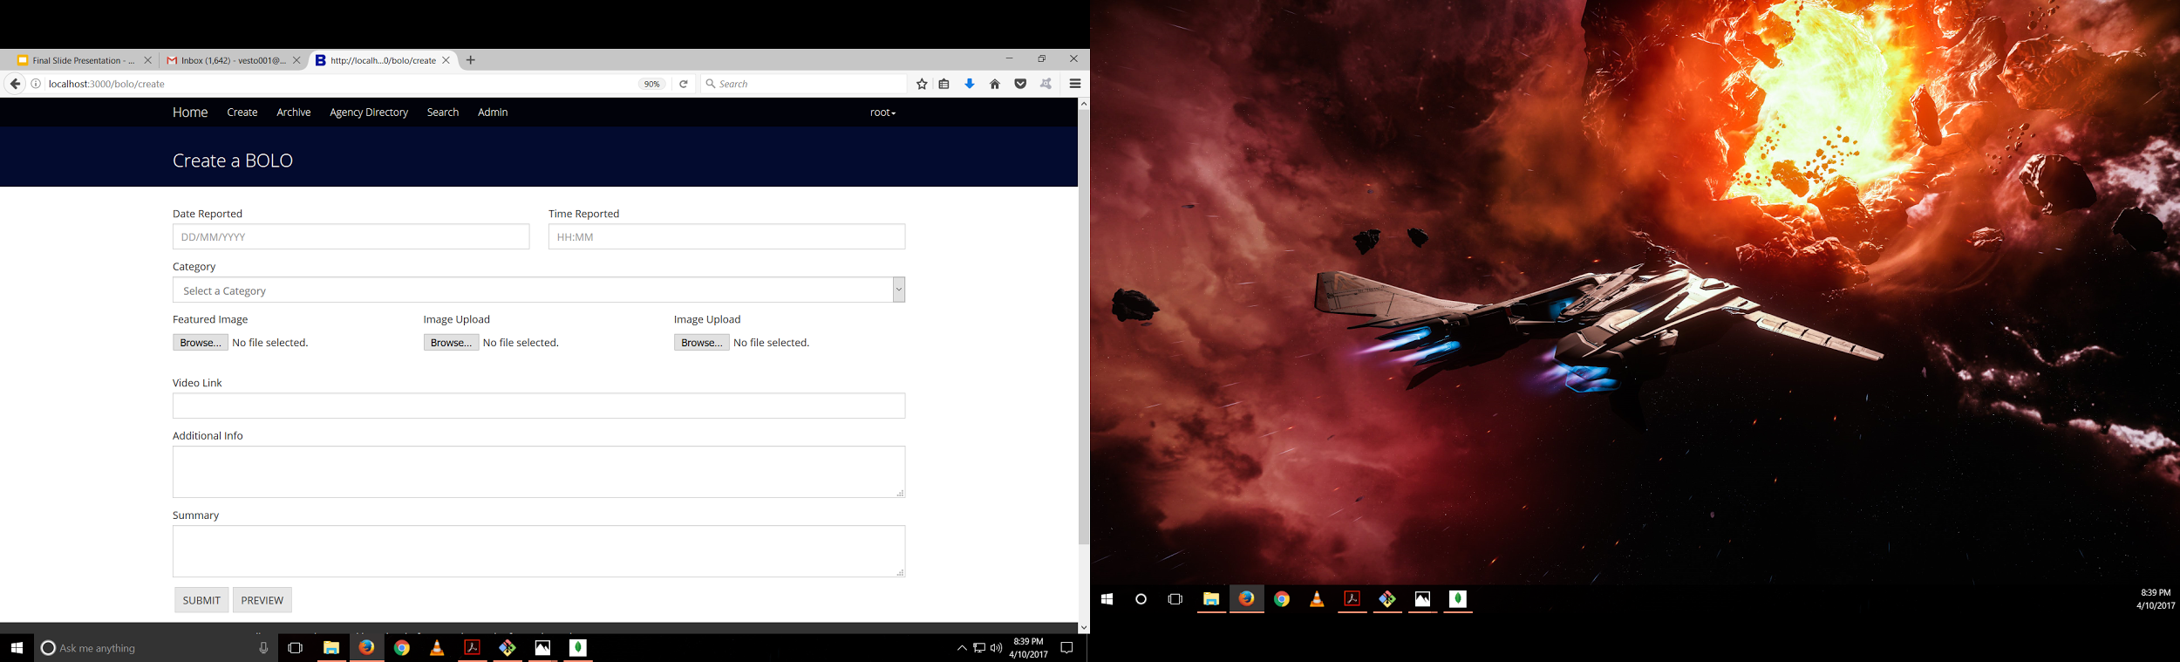
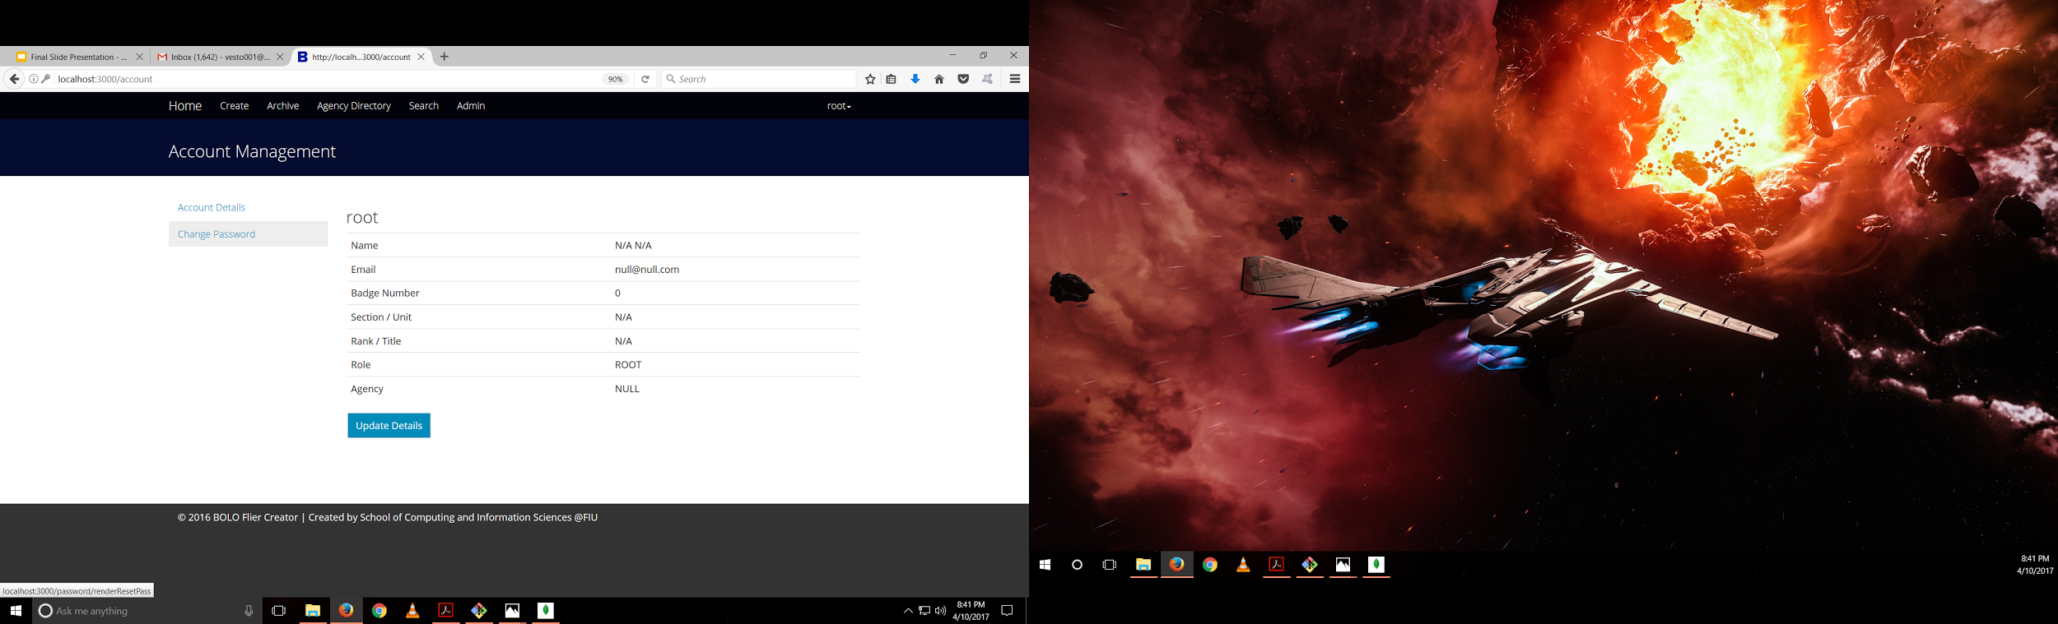
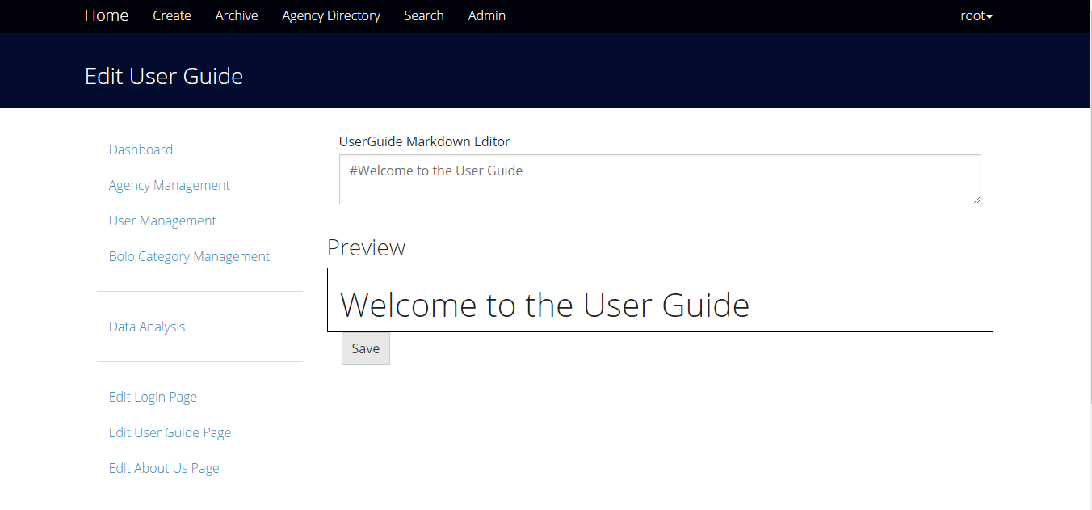
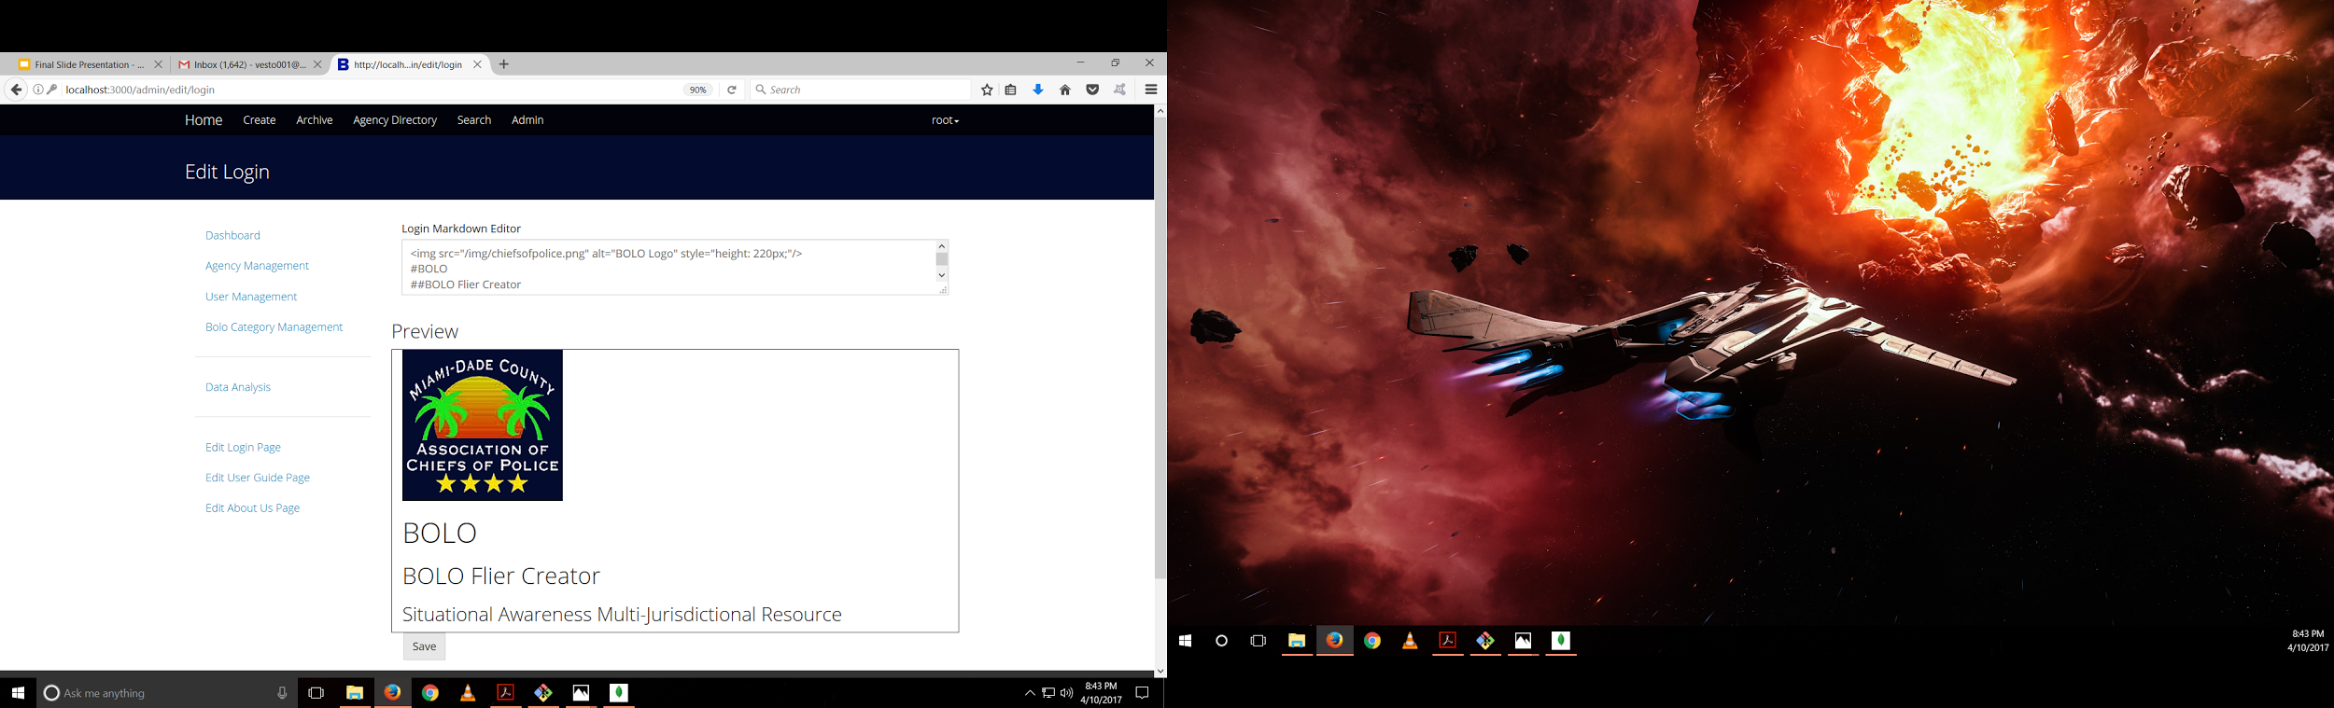
Project definition
Notes:
10 seconds.
Introduce the problem that the whole project (in all versions) tackles with GIF or screenshot.

Slide 3

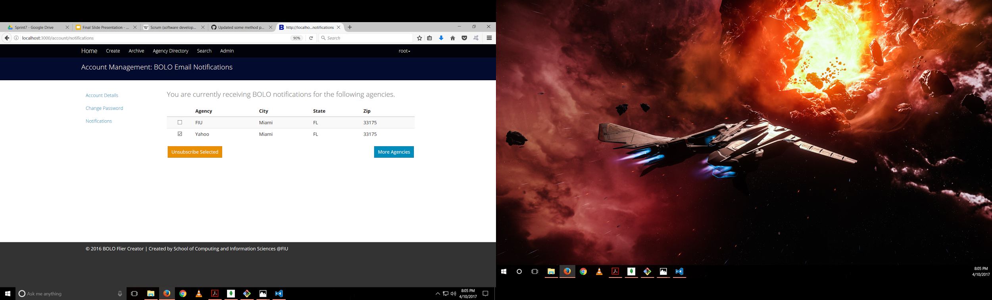
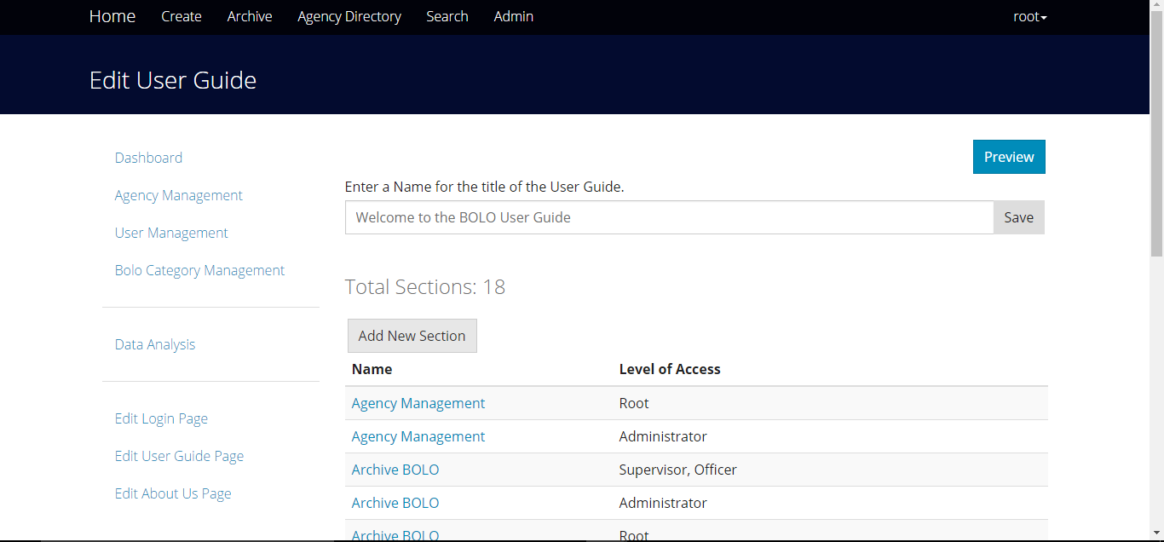
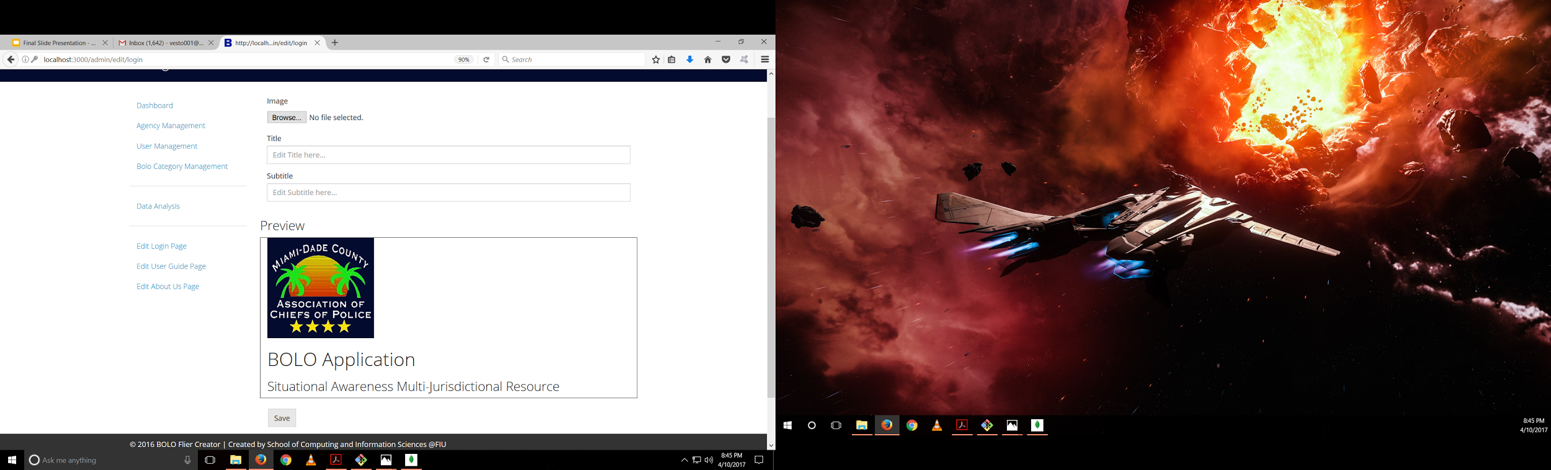
Project definition
Notes:
20 seconds.
Introduce the problem that the your project (in new version) tackles with GIF or screenshot.

Slide 4
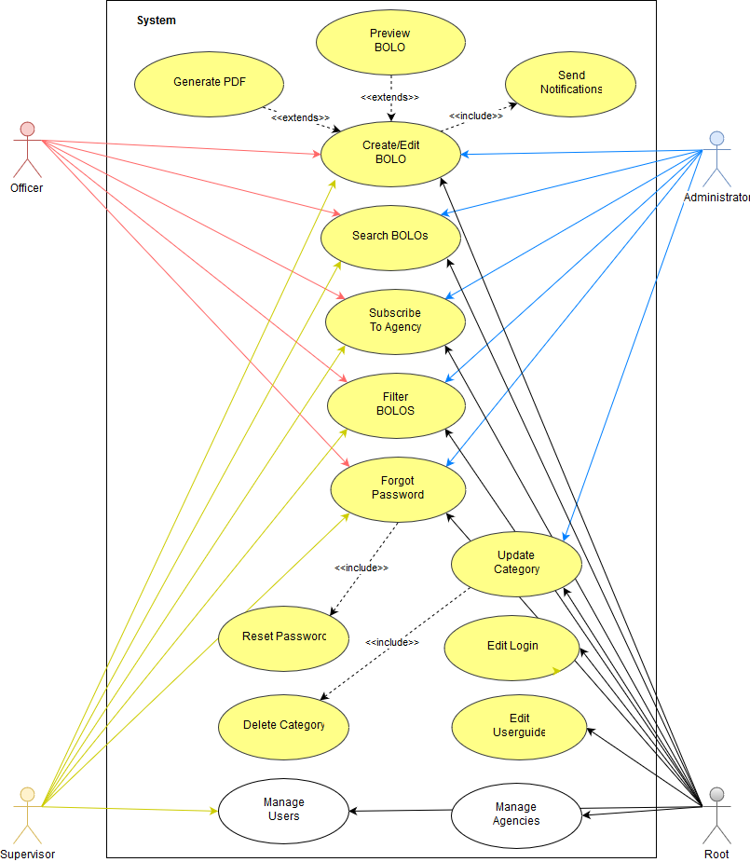
Requirements: Use Cases
Notes:
5 seconds
Show the Use Case Diagram for the whole project. Highlight your use cases.

Slide 5
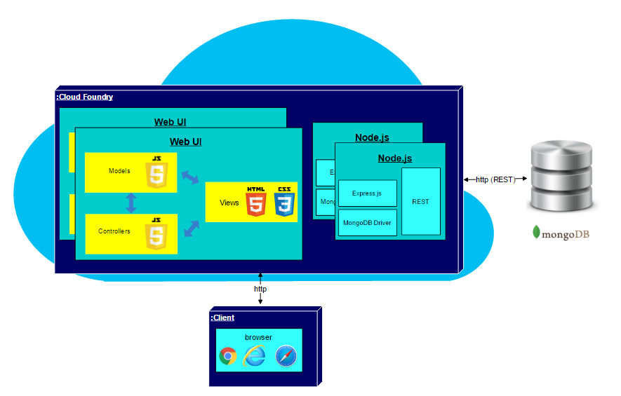
System Design: Architecture
BOLO 7.0 uses a combination of the MVC and 3-tier architecture.
H/W Requirements:
Windows/Apple Computer
Min of 8Gb of RAM
At least 30 GB of disk space
At least 2.0 GHZ processor
Notes:
20 seconds
System design: Highlight the parts that you contributed to them.
1. System decomposition; identify the architecture patterns used
2. System deployment – h/w and s/w requirements

Slide 6
Minimal Class Diagram
The minimal class diagram represents the static view of the BOLO application. It is not only used to visualizing and describing aspects of the system but also for constructing executable code of the software application.
Notes:
10 seconds.Minimal class diagram. Highlight the classes that you created/modified
Identify the design patterns used (one or more slides).

Slide 7
User Stories
1.#1328 - Add Internal Option to Create BOLO Form
2.#1286 - Notifying Users Subscribed To Agency
3.#1288 - Edit Login Page
4.#1287 - Edit User Guide Page
5.#1223 - BOLO Filter Not Working
6.#1265 - Subscribing to Agency
7.#1315 - Forgot Password
8.#1218 - Search Issue in the system
9.#1222 - Validate Password
Notes:
5 seconds.
List the user stories that you worked on them.(put in order of importance). Stay focused on the parts that you have been working.

Slide 8
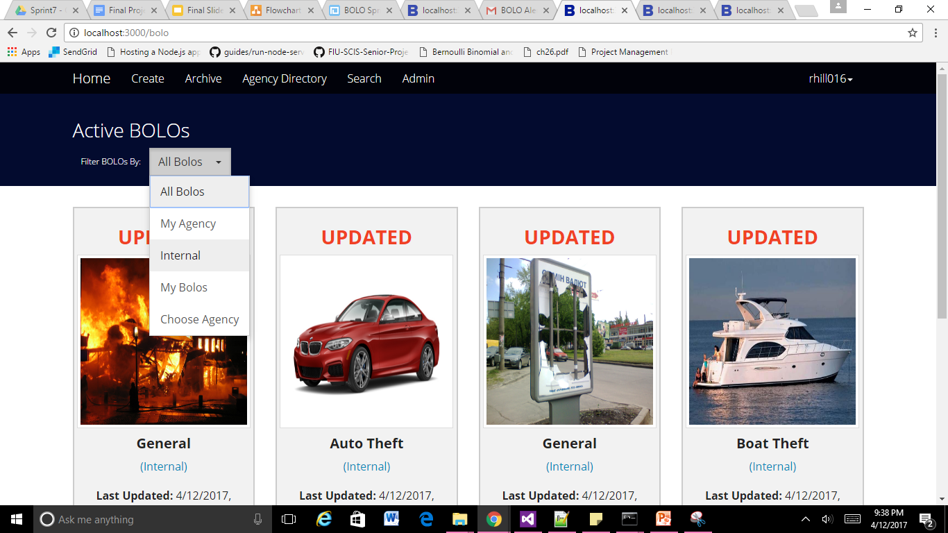
#1328 - Add Internal Option to Create BOLO Form
The added functionality allows any user to create a BOLO that is only visible within the user’s agency.
An option to filter internal BOLOs was also implemented into the system.
if (bolo.internal && bolo.agency == user.agency)
display(bolo);
else
hide(bolo);
Notes:
60 seconds
The tile of user story
The most important user story you worked on it. You have to describe this one very well and be proud of that.
Please present and show the complexity of your work, code, algorithms, and technical challenges and technologies you have used. (you could use screenshot if you want. Visual presentations are better than text presentation)
Go into the details of the most important/significant tasks using bullet lists or visual graphs or state chart diagram
Sequence Diagram for this user story is mandatory (in another separate page if required)
Demo using screenshots or GIF (in another separate page if required)

Slide 9
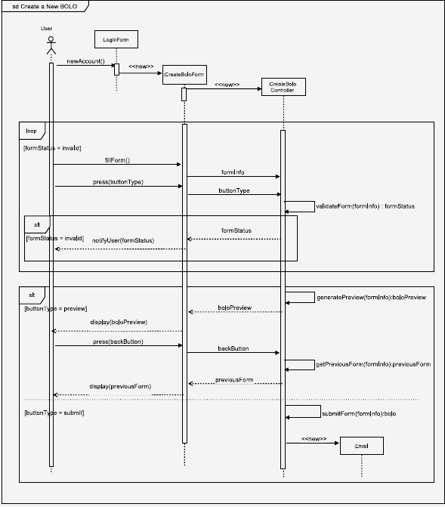
#1328 - Sequence Diagram

Slide 10
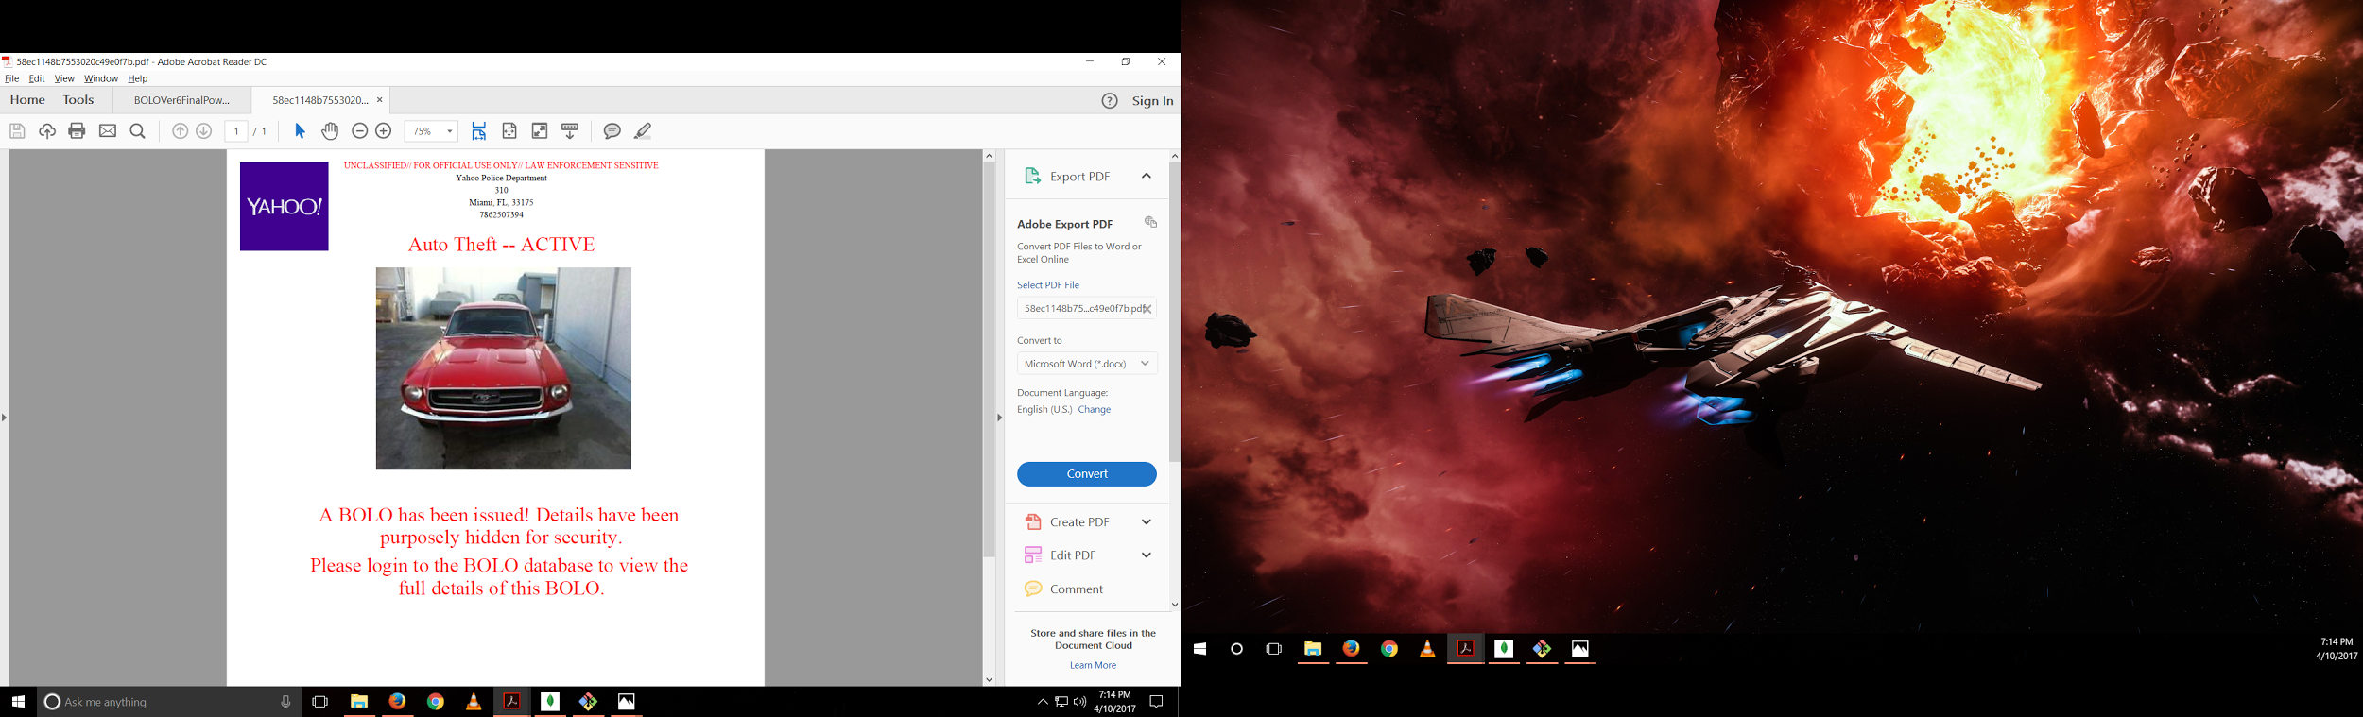
#1286 - Notifying Users Subscribed To Agency
After a BOLO is created or updated, subscribed users to the BOLO or its agency will be sent a notification.
The notification will be a short message accompanied of a pdf.
Notes:
20 seconds
The tile of user story
Please present and show the complexity of your work, code, algorithms, and technical challenges and technologies you have used. (you could use screenshot if you want. Visual presentations are better than text presentation) - Go into the details of the most important/significant tasks using bullet lists or visual graphs or state chart diagram - Demo using screenshots or GIF (in another separate page if required)
Sequence Diagram for this user story is optional

Slide 11
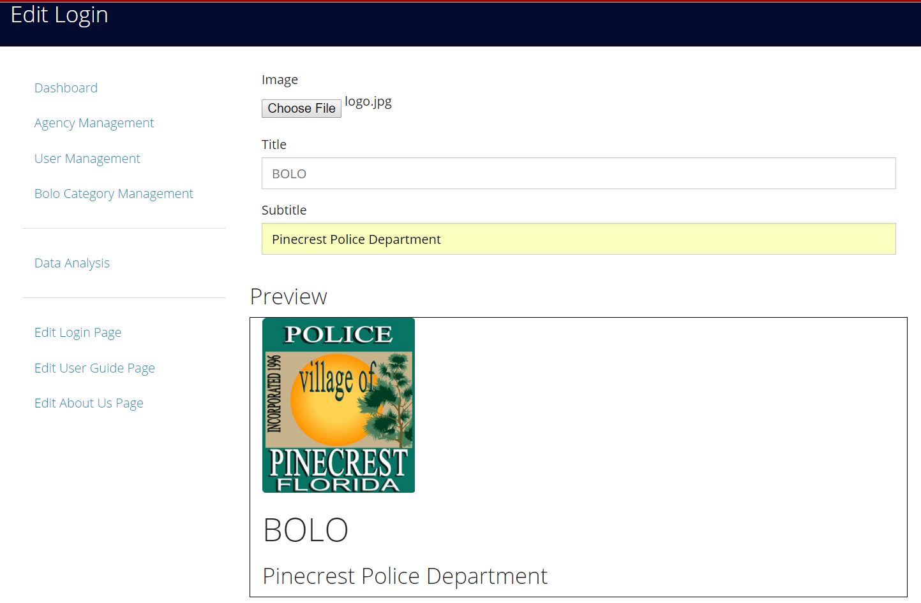
#1288 - Edit Login Page
The root should be able to edit the logo image, the title and subtitle of the application in the login page.
The edit login page should show a preview of logo image, title and subtitle.
Notes:
20 seconds
The tile of user story
Please present and show the complexity of your work, code, algorithms, and technical challenges and technologies you have used. (you could use screenshot if you want. Visual presentations are better than text presentation) - Go into the details of the most important/significant tasks using bullet lists or visual graphs or state chart diagram - Demo using screenshots or GIF (in another separate page if required)
Sequence Diagram for this user story is optional

Slide 12
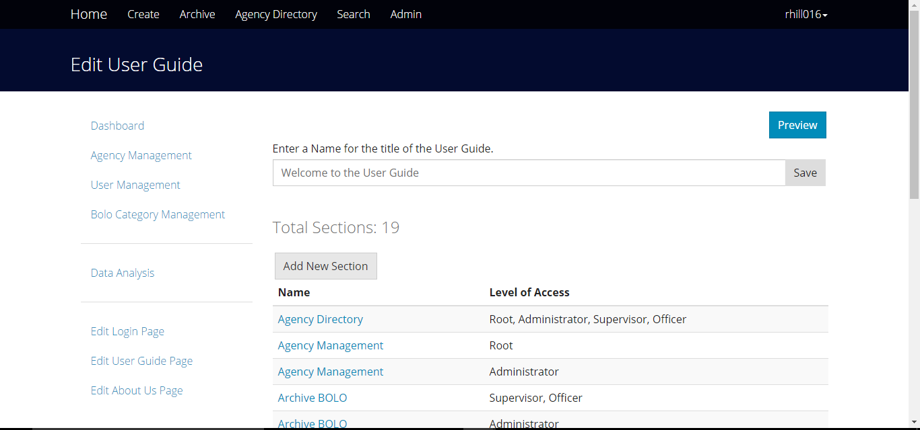
#1287 - Edit User Guide Page
The functionality allowed the root user to add, edit, or delete any section of the user guide.
The root user could also change the title of the user guide.
Notes:
20 seconds
The tile of user story
Please present and show the complexity of your work, code, algorithms, and technical challenges and technologies you have used. (you could use screenshot if you want. Visual presentations are better than text presentation) - Go into the details of the most important/significant tasks using bullet lists or visual graphs or state chart diagram - Demo using screenshots or GIF (in another separate page if required)
Sequence Diagram for this user story is optional

Slide 13
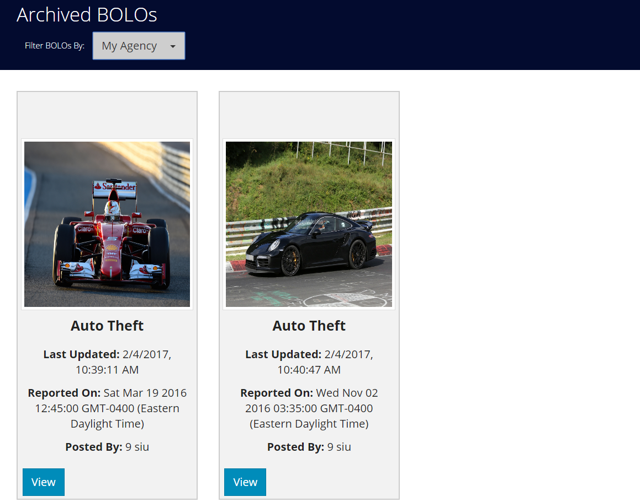
#1223 - BOLO Filter Not Working
The user can filter the archived BOLOs by:
all BOLOs
My Agency
My BOLOs
The user can see BOLOs from different agencies
Notes:
20 seconds
The tile of user story
Please present and show the complexity of your work, code, algorithms, and technical challenges and technologies you have used. (you could use screenshot if you want. Visual presentations are better than text presentation) - Go into the details of the most important/significant tasks using bullet lists or visual graphs or state chart diagram - Demo using screenshots or GIF (in another separate page if required)
Sequence Diagram for this user story is optional

Slide 14

#1265 - Subscribing to Agency
Allow users to subscribe or unsubscribe from all BOLOs belonging to the selected agencies.
Subscribed users will receive BOLO notifications from said agencies.
Notes:
20 seconds
The tile of user story
Please present and show the complexity of your work, code, algorithms, and technical challenges and technologies you have used. (you could use screenshot if you want. Visual presentations are better than text presentation) - Go into the details of the most important/significant tasks using bullet lists or visual graphs or state chart diagram - Demo using screenshots or GIF (in another separate page if required)
Sequence Diagram for this user story is optional

Slide 15
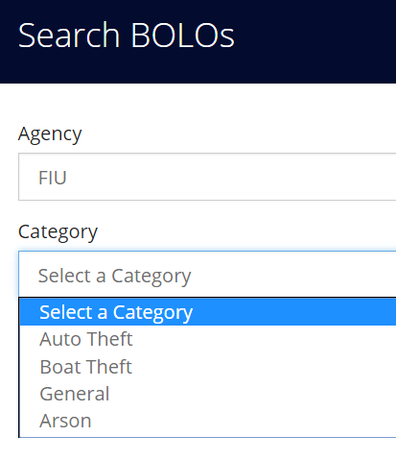
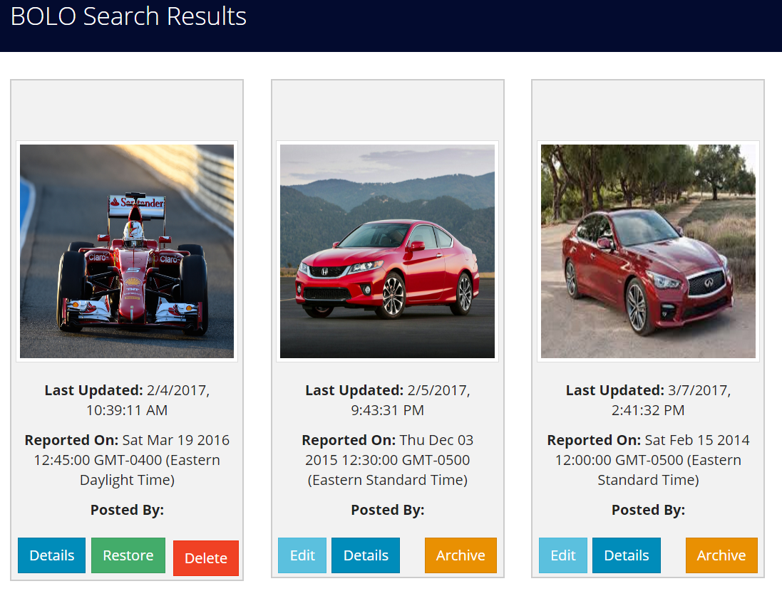
#1218 - Search Issue in the System
Any User (Officer, Admin or Supervisor) can search any BOLO without the system scratch
Any User can search any BOLO by Category by setting the category in the drop down select box
Any User can Search any BOLo by Agency by setting the agency in the drop down select box
Once the user search under any category, user can enter any keyword in the text boxes to search BOLOs
Notes:
20 seconds
The tile of user story
Please present and show the complexity of your work, code, algorithms, and technical challenges and technologies you have used. (you could use screenshot if you want. Visual presentations are better than text presentation) - Go into the details of the most important/significant tasks using bullet lists or visual graphs or state chart diagram - Demo using screenshots or GIF (in another separate page if required)
Sequence Diagram for this user story is optional

Slide 16
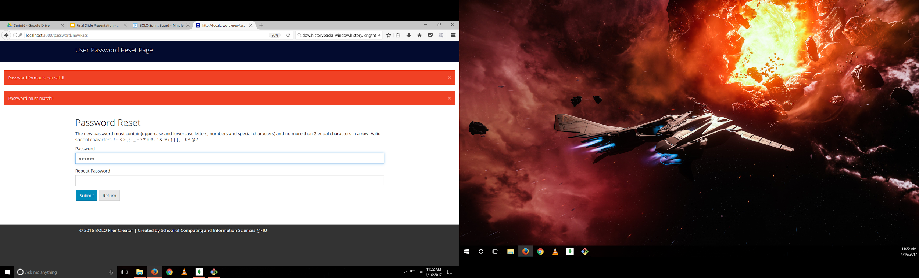
#1222 - Validate Password
Password must match with second password
Users cannot create password with just one panel
System does not crash when user enters only second password
Notes:
20 seconds
The tile of user story
Please present and show the complexity of your work, code, algorithms, and technical challenges and technologies you have used. (you could use screenshot if you want. Visual presentations are better than text presentation) - Go into the details of the most important/significant tasks using bullet lists or visual graphs or state chart diagram - Demo using screenshots or GIF (in another separate page if required)
Sequence Diagram for this user story is optional

Slide 17
Test Suites and Test Cases
ID | User_Guide_01
Purpose | Sunny day test to create a new section of the User Guide.
Preconditions | The user has a root account. The user has invoked the option to edit the User Guide. The user has selected the option to add a new section.
Input | Level of Access: Root, Administrator, Supervisor, Officer Section Heading: Logout Instructions: 1. Select username. 2. Select Logout. Click Save.
Expected Output | A new section called Logout is added to the User Guide.
ID | User_Guide_02
Purpose | Rainy day test to verify that an empty section of the User Guide could not be added.
Preconditions | The user has a root account. The user has invoked the option to edit the User Guide. The user has selected the option to add a new section.
Input | Click save.
Expected Output | An error message notifying the user that the section heading and instructions are required.
Notes:
10 seconds
A description of verification process and Test Suites and Test Cases for one of the use cases.
1 One sunny day and one rainy day for the implemented use cases (one or more slides).
2 Automated test scripts for the implemented use cases (if any) (one or more slides).

Slide 18







Summary
BOLO-7.0 was managed using the Scrum development process. Project members participated in 7 sprints, completing 1-2 user stories bi-weekly.
Contact Information:
Mario Siu - msiu001@fiu.edu
Rachel Hill - rhill016@fiu.edu
Victor Estopiñán - vesto001@fiu.edu
Notes:
10 seconds
Summarize your contribution, mention your effort for Scrum, Mingle, Github, Google Drive Documentation and minutes
Include your contact information
Ask if anyone has any questions for you.
Thank your audience

